Slide 1


Gaining Insights: Uni- & Bivariate Analysis
IL “Data and Decision Making” SS 26
Kami Höferl
(MervC, CC-BY-NC 2.0)

Slide 2
Overview
Meet Jamovi
Importing Data
Uni-, Bi- or Multivariate?
Univariate Analysis
Bivariate Analysis
(MervC, CC-BY-NC 2.0)
(Escher, 1961)

Slide 3
Meet Jamovi

Slide 4


Statistical Software
Software | Typischer Einsatz | Lizenz / Modell
Python (SciPy, pandas, statsmodels) | Statistik, Data Science | Open Source (verschiedene OSS-Lizenzen)
R | Breites Spektrum von Statistik bis Data Science | Open Source (GPL)
PSPP | Grundlegende Statistik, SPSS-ähnlich | Open Source (GPL)
Jamovi | Lehre, explorative Statistik, GUI-basiert | Open Source (GPL)
JASP | Bayes-Statistik, Inferenz, Lehre | Open Source (AGPL)
SAS | Große Datensätze, institutionelle Analysen | Proprietär (kommerziell)
SPSS | Deskriptive Statistik, Regression, klassische Inferenz | Proprietär (kommerziell)
AMOS | Strukturgleichungsmodelle (SEM), grafisch | Proprietär (kommerziell, SPSS-Addon)
Stata | Regressionsanalyse, Paneldaten, angewandte Ökonometrie | Proprietär (kommerziell)
Mplus | Strukturgleichungsmodelle, Latent-Variable-Modelle | Proprietär (kommerziell)

Slide 5



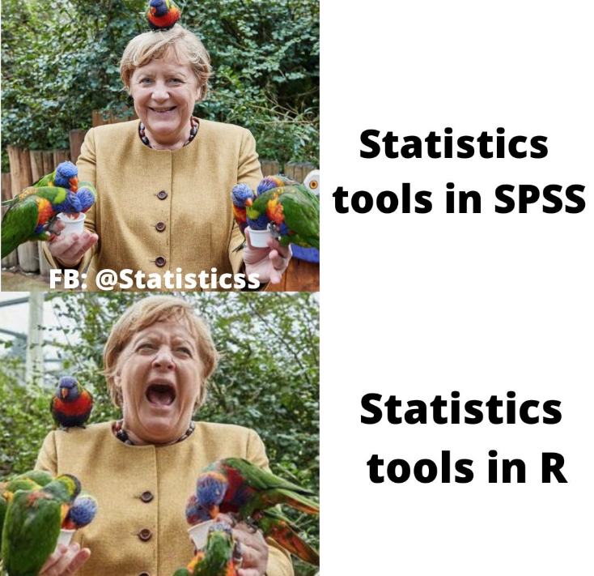
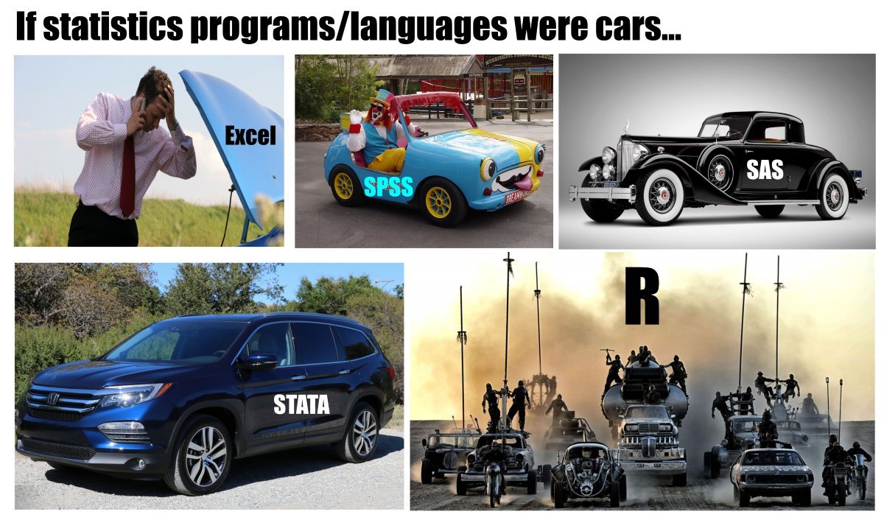
Please: Stay Calm …

Slide 6

An Example: jamovi

Slide 7

A Recommendation:

Slide 8
A typical Workflow
Reduction
Imputation
Aggregation
Classification
Generalisation
Documentation
Encoding problems
Data types
Labels
Completeness
Missing Values
Plausibility
Collect
Repositories
Define research questions
Data acqui-sition
Import data
Explore & validate data
Modify data
Model data
Validate models
Evaluate models
Documentation
Summarise findings
Univariate
Bivariate
Multivariat
Segment data record
Sensitivity analysis
Explanatory power
Number of variables
Effect strength

Slide 9
Importing & Validting Data

Slide 10
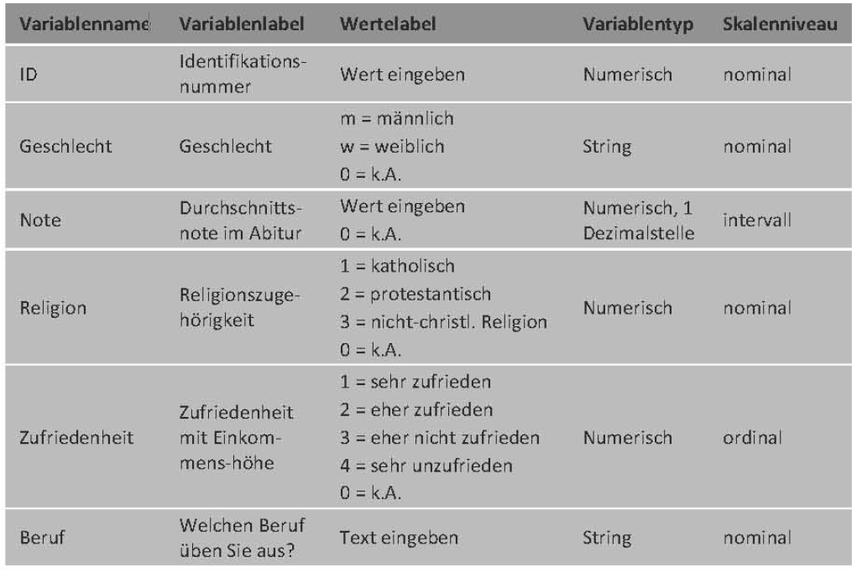
The Codeplan

Slide 11
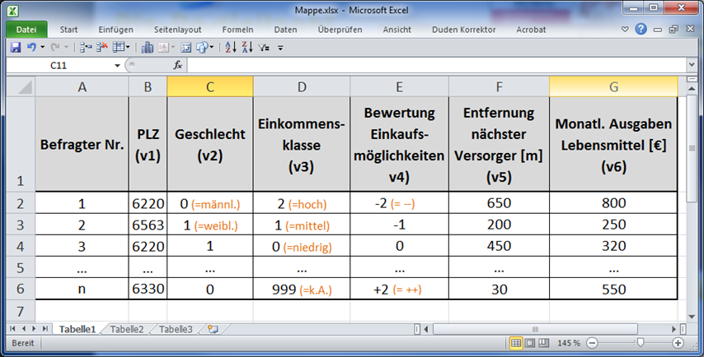
The Codeplan

Slide 12
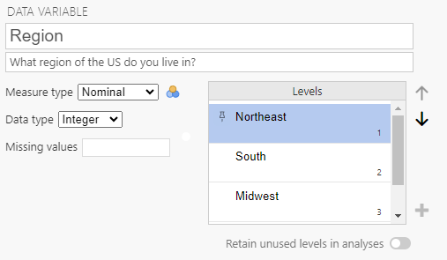
Data Labels in Jamovi

Slide 13
I don’t Know = Nothing?
Many reasons: refusal to answer, age=225, multiple answers, illegible, etc.
→ Always transfer to data table:
Leave field blank
Encoding (e.g.: 999- -9, NA)
Why?
Statistical programmes can take "missing values" into account when calculating statistical parameters 👉 define what constitutes a "missing value"

Slide 14

An Example

Slide 15
An Example
What is the general attitude towards the use of wind energy among Austrian households?
Exposure, urban-rural gradient, political orientation, conspiracy mentality
Do Austrian households discriminate in their approval of different approaches to wind energy use?
Type of plant, localisation, shareholdership
👨‍💻Preregistration: doi.org/10.17605/OSF.IO/SU8H2

Slide 16
An Example
Online survey:
Sampling proportional to:
age, gender, education, population distribution between Austrian federal states
Field phase: 04/15/24 to 05/07/24
1.642 complete 👉 1.453 valid responses
duration & uniform response behaviour
Structural similarity sample-population: +/- 1%

Slide 17

An Example
doi.org/10.17605/OSF.IO/SU8H2

Slide 18
Uni-, Bi- or Multivariate?

Slide 19
Uni-, bi- and multivariate Analysis
Univariate Analysis:
Examines one variable at a time
Focuses on describing distribution, central tendency and dispersion
Typical measures: mean, median, variance, standard deviation
Typical visualisations: histogram, boxplot, bar chart
👉 Used for descriptive insights about a single variable

Slide 20
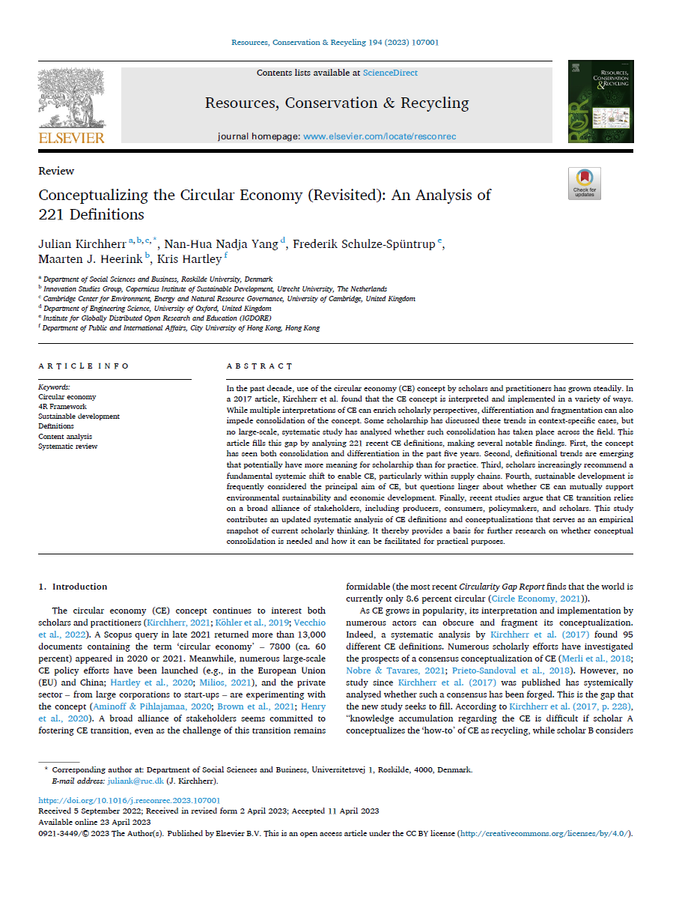
Univariate Analysis in Action

Slide 21
Uni-, bi- and multivariate Analysis
Bivariate Analysis:
Examines the relationship between two variables
Focuses on association, correlation or group differences
Typical methods: correlation analysis, simple regression, t-test, chi-square test
Typical visualisations: scatterplot, grouped bar chart, line chart
👉 Used to explore whether and how two variables are related

Slide 22
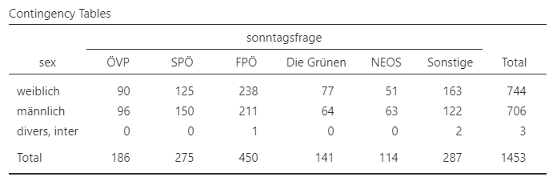
Bivariate Analysis in Action

Slide 23
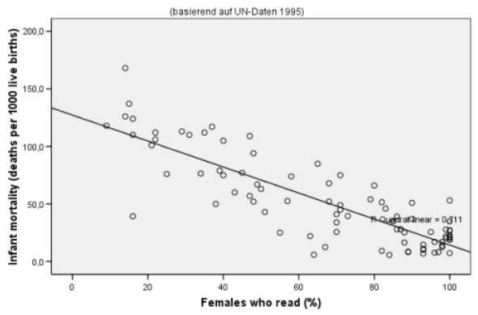
Bivariate Analysis in Action

Slide 24
Uni-, bi- and multivariate Analysis
Multivariate Analysis:
Examines more than two variables simultaneously
Focuses on complex relationships and interaction effects
Typical methods: multiple regression, MANOVA, factor analysis, cluster analysis
Used to model systems with several influencing variables
Allows control for confounding variables

Slide 25
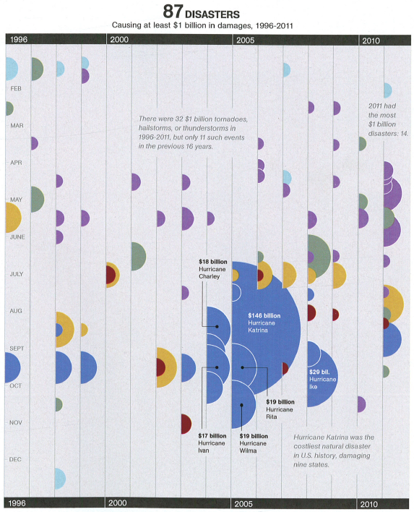
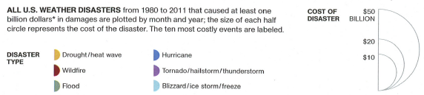
Multivariate Analysis in Action

Slide 26
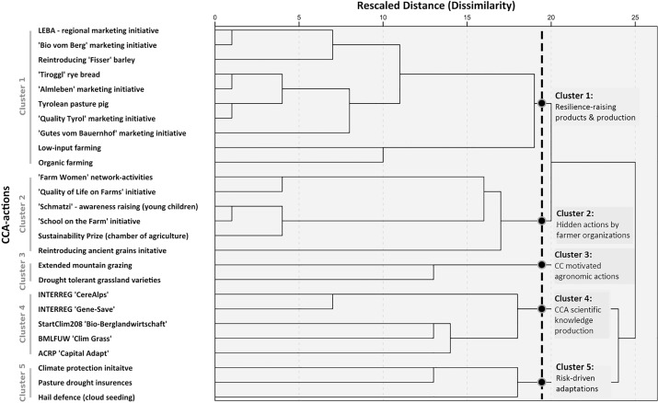

Multivariate Analysis in Action

Slide 27
Univariate Analysis

Slide 28
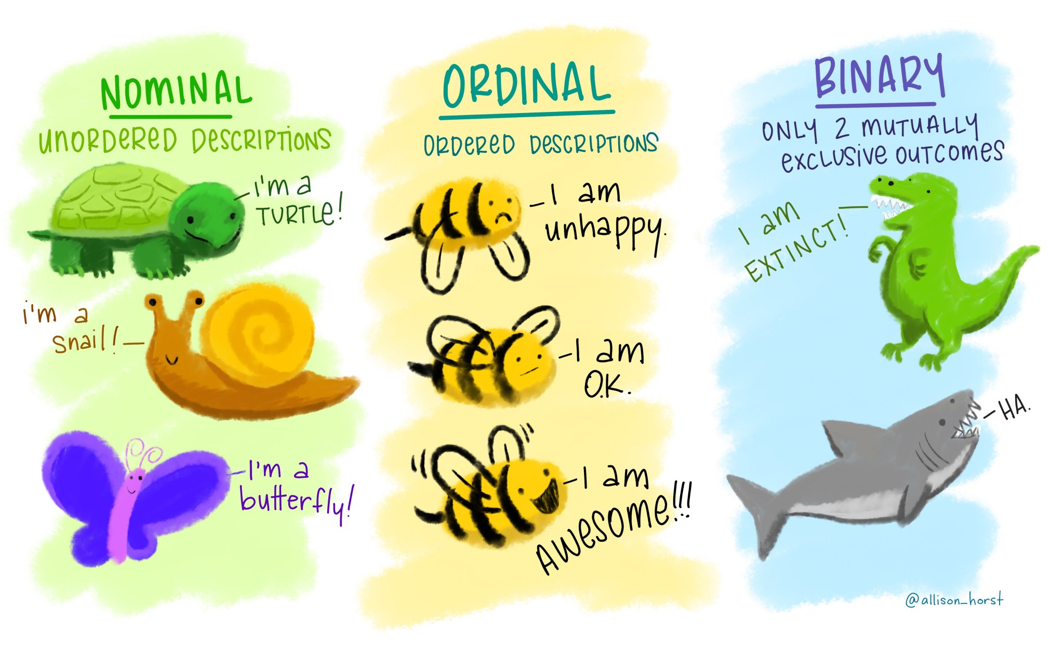
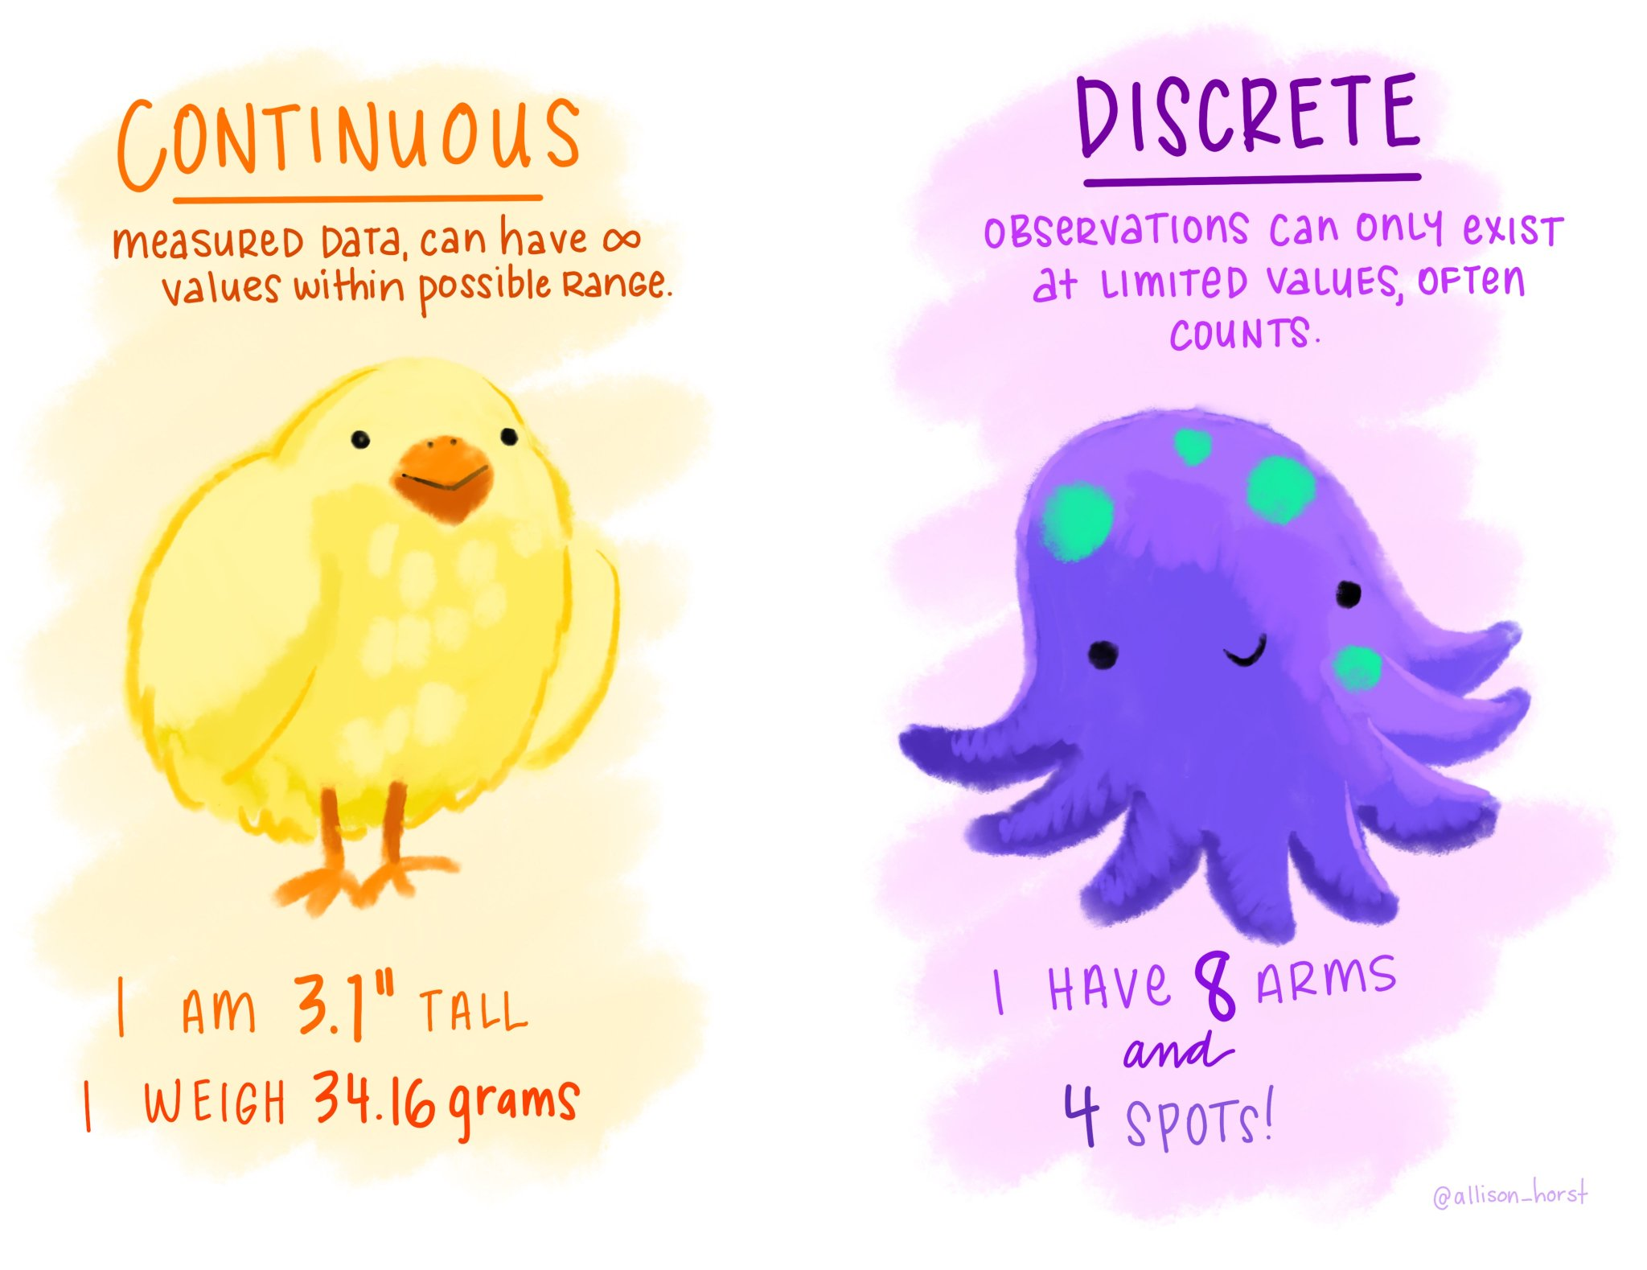

We Remember:

Slide 29
Scale Types of Quantitative Data
Scale type | Characteristics |  |  |  | Permitted arithmetic operations | Examples
 | Zero point | Distances | Ranks | Identity
Nominal scale |  |  |  | X | =, ≠ | Marital status, telephone numbers, medical classification
Ordinal scale |  |  | X | X | =, ≠, >, < | Satisfaction, military ranks, wind force
Interval scale |  | X | X | X | =, ≠, >, <, +, - | Temperature in Celcius, calendar time
Ratio scale | X | X | X | X | =, ≠, >, <, +, -, *, / | Length & weight measurement

Slide 30
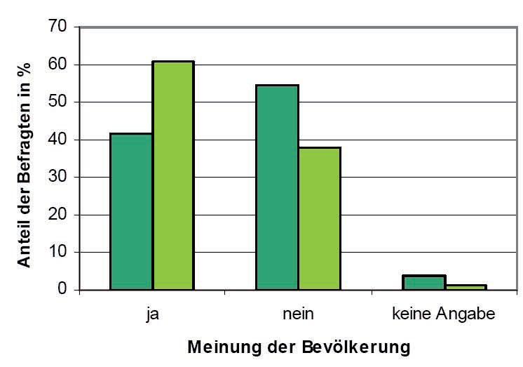
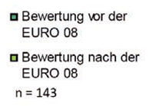
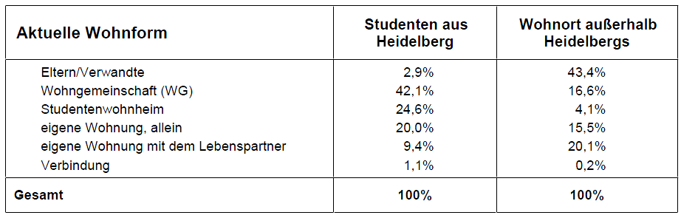
Possibilities for Describing Nominal Variables
Do you think that Tyrol as a whole will benefit in the long term from major sporting eventssuch as EURO 08?
👉 Frequency analyses
Current living arrangements of Heidelberg students by place of residence during the semester

Slide 31
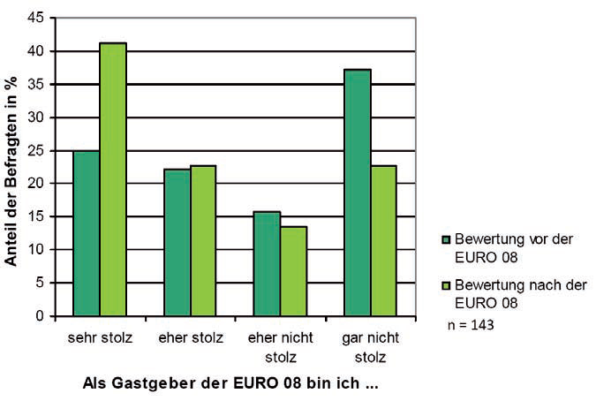
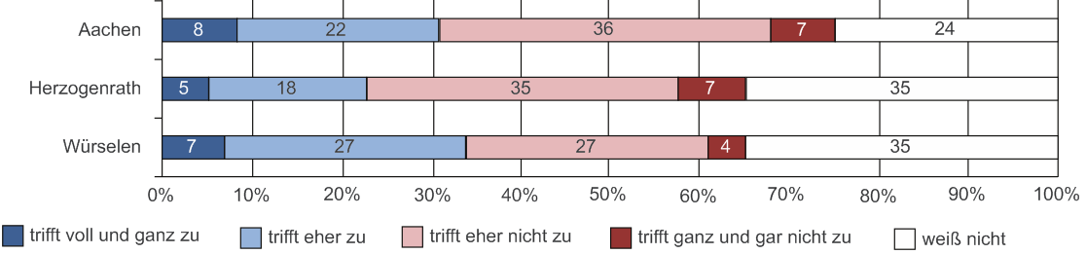
Possibilities for Describing Ordinal Variables
As a resident, are you proud to have hosted EURO 08?
👉 Frequency anlyses & rank orders
Assessments of the statement "This place is too expensive for senior citizens"

Slide 32
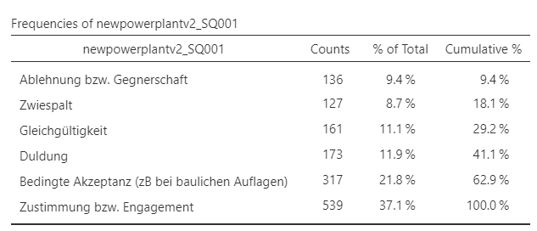
Frequency Tables
👉 number of observations in each category:
Show absolute frequencies and often relative frequencies in percent
For nominal variables, categories have no inherent order
For ordinal variables, categories follow a meaningful ranking
Help identify the most common categories and overall distribution patterns
Provide the basis for bar charts, pie charts or cumulative percentages for ordinal data

Slide 33
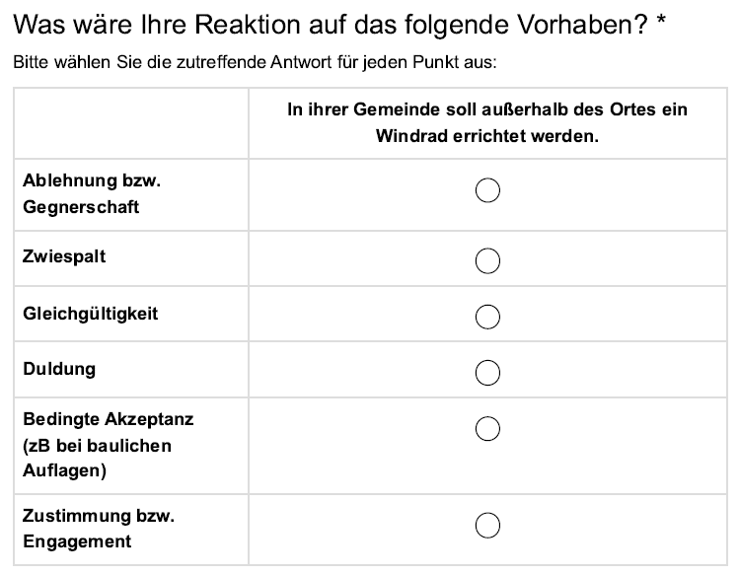
Frequency Tables

Slide 34
From Frequency to Contingency Tables
👉 Display the joint distribution of two categorical variables:
Show how frequencies are distributed across combinations of categories
Include absolute counts and often row or column percentages
Help identify patterns of association between variables
Provide the basis for statistical tests such as the Chi-square test
Commonly used for nominal or ordinal variables

Slide 35
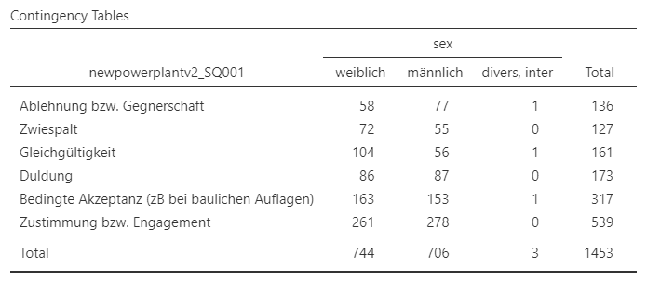
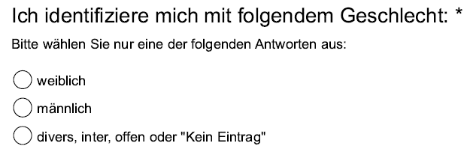
From Frequency to Contingency Tables

Slide 36
… for Metric Variables

Slide 37
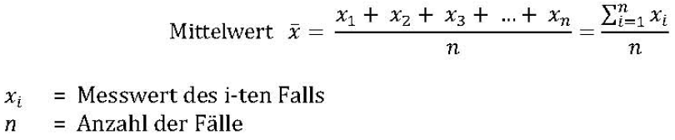
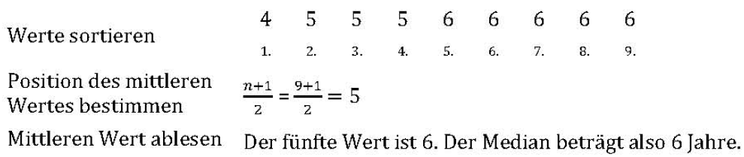
Position Dimensions of Metric Variables
The classic: the arithmetic mean (Excel: MITTELWERT)
The median: divides a data set in the middle( Excel: MEDIAN)
50% of values above and below
Notes:
Digression "Mode": the most frequent value
→ does not have to be unique // works across all scale levels

Slide 38
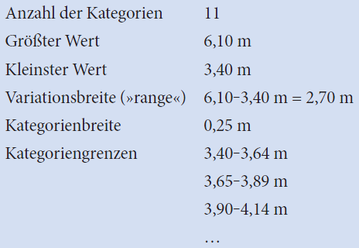
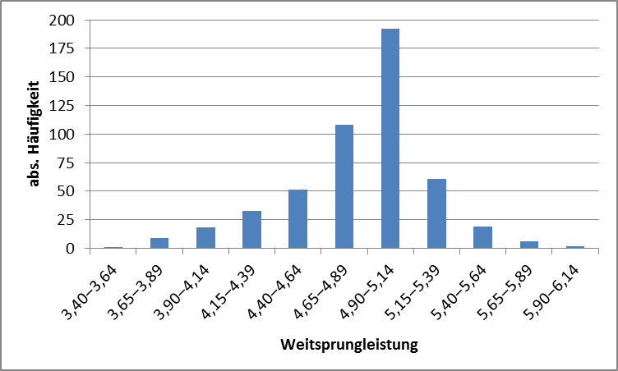
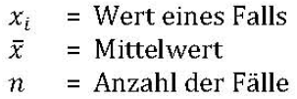


Dispersion of Metric Variables
Graphical representation using categorisation (👉 histogram)
Classical measures of dispersion: The variance & standard deviation

Slide 39
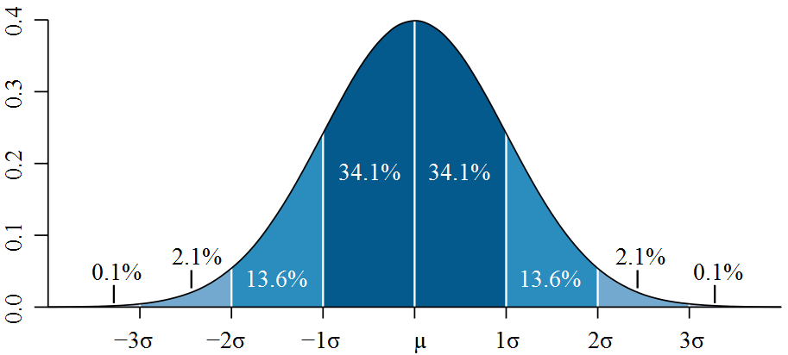
Digression: The Significance of Standard Deviation
Density for standard normal distribution
68,3%
95,5%
99,7%

Slide 40
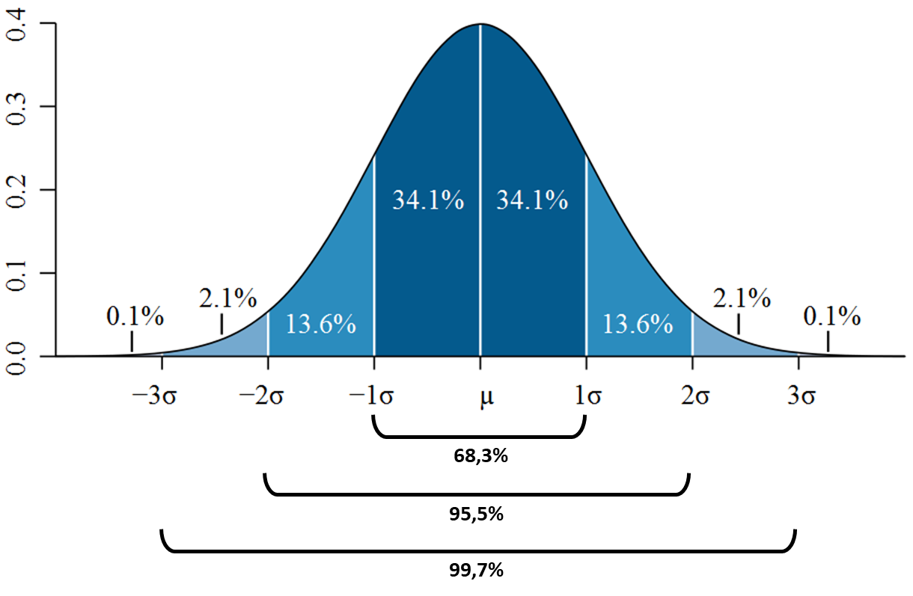
Digression from the Digression: Normal Distribution?
Normal Distribution:
A continuous, symmetric probability distribution centred around the mean
Characterised by its bell-shaped curve
Mean, median and mode are identical
Fully described by two parameters: mean and standard deviation
Special case: Standard Normal Distribution
A special case of the normal distribution with mean 0 and standard deviation 1
Also called Z-distribution

Slide 41
Digression from the Digression: Normal Distribution?
Why does it matter?
Many natural and social phenomena approximate normality
Forms the basis of many parametric tests such as the t-test
Underlies confidence intervals and hypothesis testing
Supported by the Central Limit Theorem, which justifies normal approximations for large samples

Slide 42
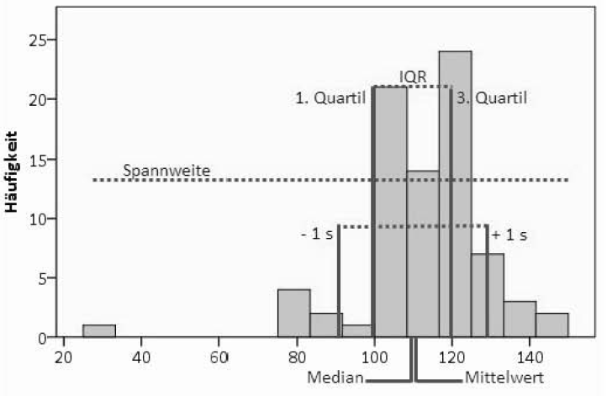
Visualising Location & Dispersion Measures of Metric Variables

Slide 43
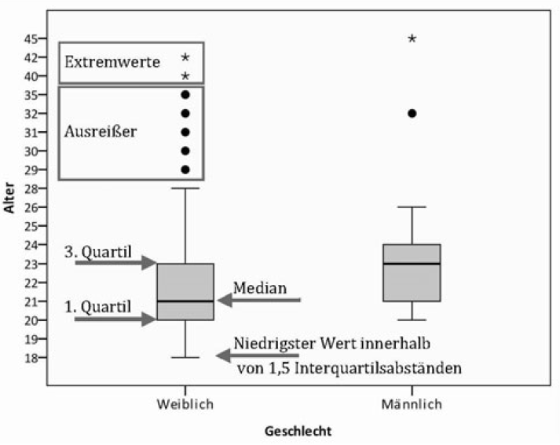
A well-known Alternative: The Box Plot
Showing:
Median
Data dispersion (quartiles)
Interpretation:
Box: middle 50%
Whiskers: Values within 1.5 times the interquartile range (Q75-Q25) around the median
Extreme values: Values outside the 3-fold interquartile range from the median

Slide 44
Everythings hangs Together …

Slide 45

Bivariate Analysis: The Relationship between Two Variables
Correlation:
strength and direction of association between two variables
how variables move together
Often quantified by the correlation coefficient r
👉 Does not imply a cause-effect relationship

Slide 46
Bivariate Analysis: The Relationship between Two Variables
Causation:
A relationship in which one variable directly influences or produces a change in another
Implies a cause-effect mechanism
Requires stronger evidence such as experimental control or robust causal design
👉 Cannot be concluded from correlation alone

Slide 47
Bivariate Analysis: The Relationship between Two Variables

Slide 48
An Overview of selected Correlation Measures
Image Slide
Independent variable | Dependent variable
 | nominal | ordinal | metric
nominal | χ², Cramers V | ← | ← Eta, Eta²
ordinal |  | Spearmans Rho, Kendalls Tau | Eta, Eta²
metric |  |  | Bravais-Pearson-correlation
Notes:
# Strategie 1: metrische Daten durch Klassifikation in ordinale Daten überführen → Informationsverlust
# Strategie 2: Eta → geht mit nominal und ordinalen unabhängigen Variablen
abhängig: zu erklärende Variable
Unabhängig: Erklärende Variable

Slide 49
Association among Nominal Variables

Slide 50
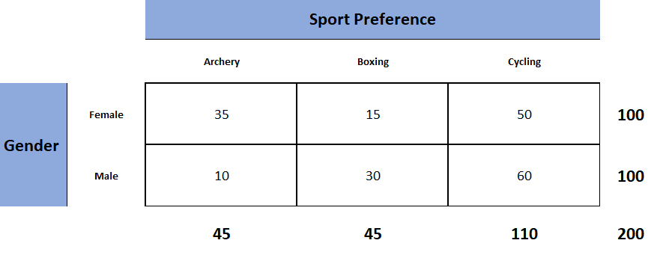
Association between Two Nominal Variables
Startingpoint: Contingency table with 👉 “observed” values

Slide 51
Association between Two Nominal Variables: The Chi² Test
non-parametric test for categorical data
Examines whether there is an association between two categorical variables
Compares observed frequencies with expected frequencies under independence
Based on the chi-square statistic χ²
Requires sufficiently large expected cell frequencies
Greater than 5

Slide 52
Association between Two Nominal Variables: The Chi² Test
Null hypothesis H0: There is NO statistically significant association between the two variables (= “Independence”)
Hypothesis H1: There is a statistically significant association between the two variables (= “Dependance / Association”)

Slide 53
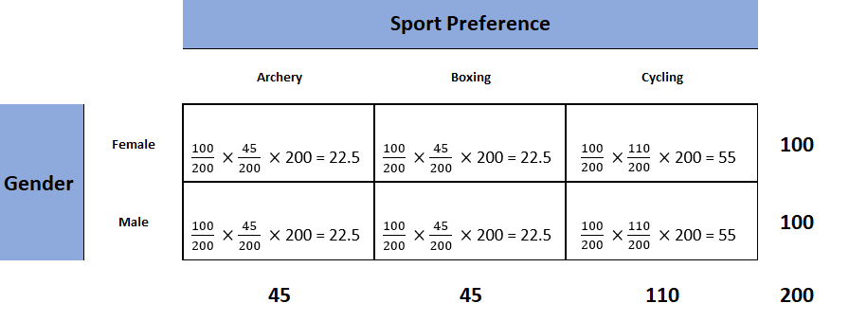
Association between Two Nominal Variables: Chi²-Test the Old School Way
Second step: calculate expected frequencies from the margins

Slide 54
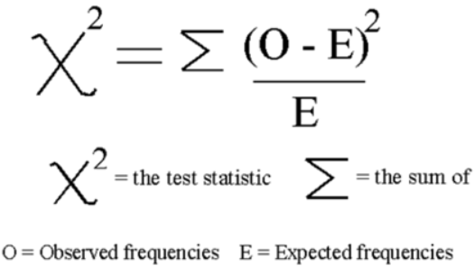

Association between Two Nominal Variables: Chi²-Test the Old School Way
Third step: summarise the differences 👉 Chi² value
Fourth step: calculate the “Degrees of Freedom (df)”

Slide 55
And On More Thing: Alpha (α) and its Importance for Tests
= threshold for deciding whether a result is statistically significant
represents the risk of making a wrong decision
More precisely: probability of rejecting a true null hypothesis (“Type 1 Error”)
Chi@ test: it defines how extreme the χ² value must be to reject independence
A common choice is α = 0.05
we accept a 5 percent risk of concluding there is an association when in reality there is none
Notes:
Type 1 Error: Rejecting a true null hyothesis
Type 2 Error: Not ejecting a false null hypothesis

Slide 56
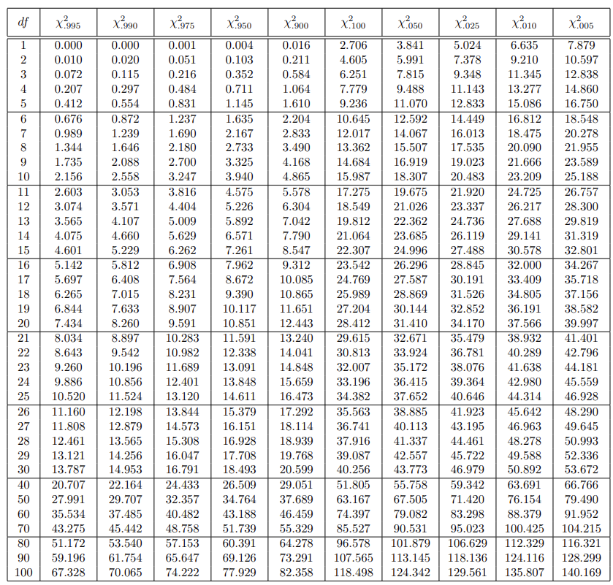
So: Back to Old School
α = 0.05
χ² = 19.8
df = (2-1) x (3-1) = 2
α = 0.05
👉 critical χ² = 5.991
19.8 > 5.991
👉 Our conclusion: Reject H₀: There is a significant association between gender and sport preference

Slide 57
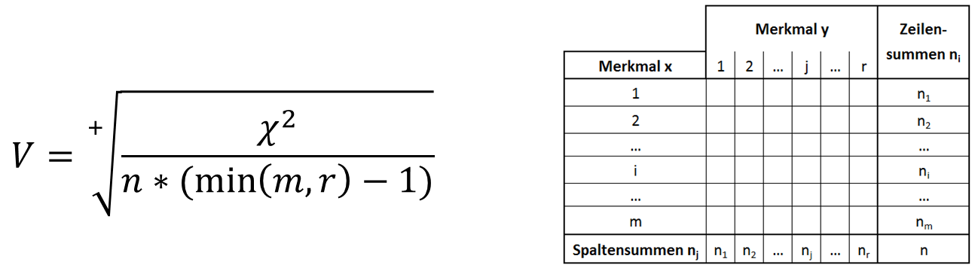

Chi²-Tests: But how Strong is the Association?
$χ^{2}$ when independence = 0 (observed = expected)
Can be arbitrarily large
👉 Standardisation [range from 0 to +1] necessary to make a statement about the strength of the association
Cramers V [0; +1]:

Slide 58
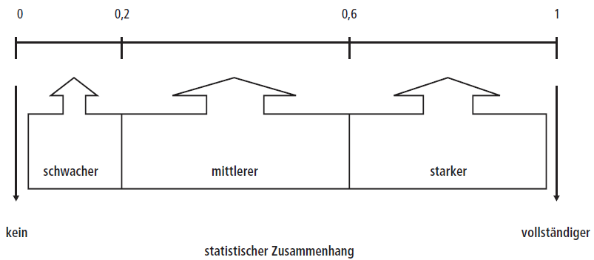
Chi²-Tests: But how Strong is the Association?
Cramers V [0; +1]:
The greater V is, the stronger the statistical association.

Slide 59
Correlation between Metric Variables

Slide 60
Let’s have a Look: Scatterplots
A graphical display of the relationship between two metric variables
Each point represents one observation with an x and a y value
👉 Used to visualise patterns, trends and direction of association
Helps identify positive, negative or no correlation
Makes outliers and clusters visible
Often used as a first step before calculating correlation or regression

Slide 61
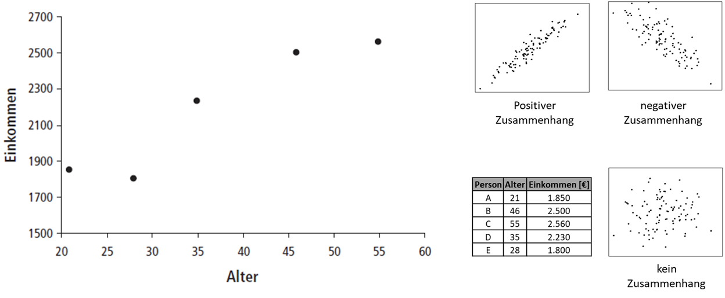
Let’s have a Look: Scatterplots

Slide 62
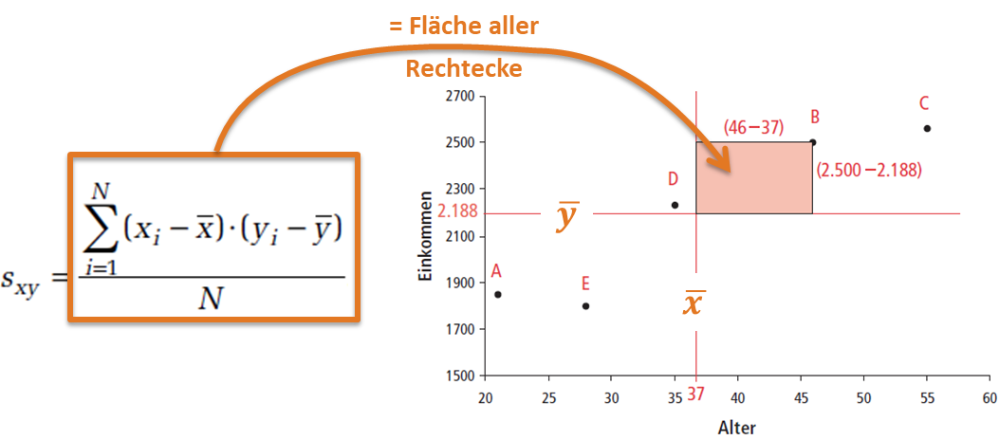
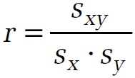
Going beyond the Plot: Measuring Correlations with Pearson’s r
Determination of Pearson’s r:
Calculating the covariance s_{xy}
covariance (like χ²-values) can be arbitrarily large
👉 Standardisation to value range -1 to +1: correlation coefficient r [-1; +1]
s_{x} … Standard deviation variable x
s_{y} … Standard deviation variable y

Slide 63
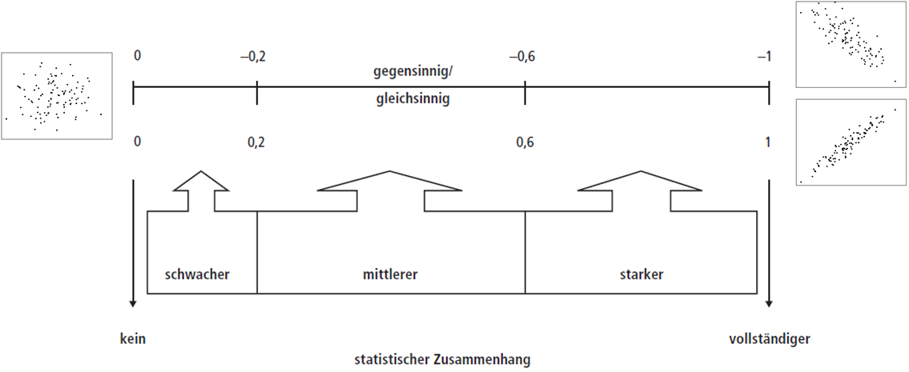
How to Make Sense of Pearson’s Correlation Coefficient r

Slide 64
Bonus: Correlations between Ordinal Variables

Slide 65
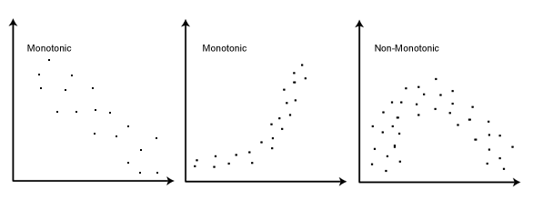


Spearmans ρ („rho“) as Ordinal Alternative
Measures monotonic relationships:
Value range: like Pearson's r (-1 to +1)
Basis: Difference in the ranks of a pair of values
n … Number of paired observations
𝑑𝑖 … ​Difference between the rank of X
and the rank of Y for observation i

Slide 66
Spearmans ρ („rho“) as Ordinal Alternative
Measures monotonic relationships:
Value range: like Pearson's r (-1 to +1)
Basis: Difference in the ranks of a pair of values
~ like Pearson’s r but based on ranks
Problem: Ties
Rule of thumb: less than ⅕ of all value pairs 👉 ranks via mean values

Slide 67
Combining Pearson’s r and Spearman’s ρ

Slide 68
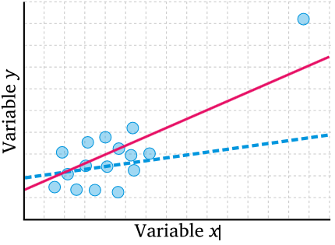


Some Limitations of Pearsons Correlation Coefficient r
Pearson's problem: Assumes linear relationship
Distortions: non-linear relationships & outliers

Slide 69
Some Limitations of Pearsons Correlation Coefficient r
Pearson's problem: Assumes linear relationship
Distortions: non-linear relationships & outliers
How to deal with it:
First: Checking the normal distribution of the variables used
Determine Pearson's r & Spearman’s ρ
👉 "significant" differences = outliers distort Pearson's r
If necessary, exclude outliers and recalculate

Slide 70
From Correlation to Regression

Slide 71
Bivariate Analysis: The Relationship between Two Variables
Correlation:
strength and direction of association between two variables
how variables move together
Often quantified by the correlation coefficient r
👉 Does not imply a cause-effect relationship

Slide 72
Bivariate Analysis: The Relationship between Two Variables
Causation:
A relationship in which one variable directly influences or produces a change in another
Implies a cause-effect mechanism
Requires stronger evidence such as experimental control or robust causal design
👉 Cannot be concluded from correlation alone

Slide 73
What is the Main Goal of Regression Analysis?
Examine the relationship between one independent variable & one dependent variable
Cause 👉 effect relationship
model how changes in the independent variable affect the dependent variable
estimate the direction and strength of this relationship
predict values of the dependent variable based on the independent variable
test whether the relationship is statistically significant

Slide 74
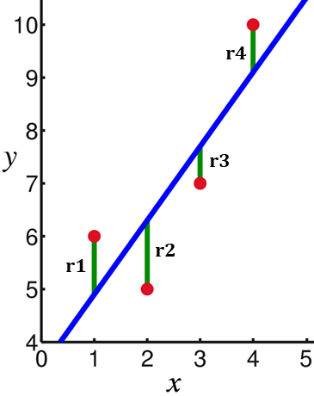
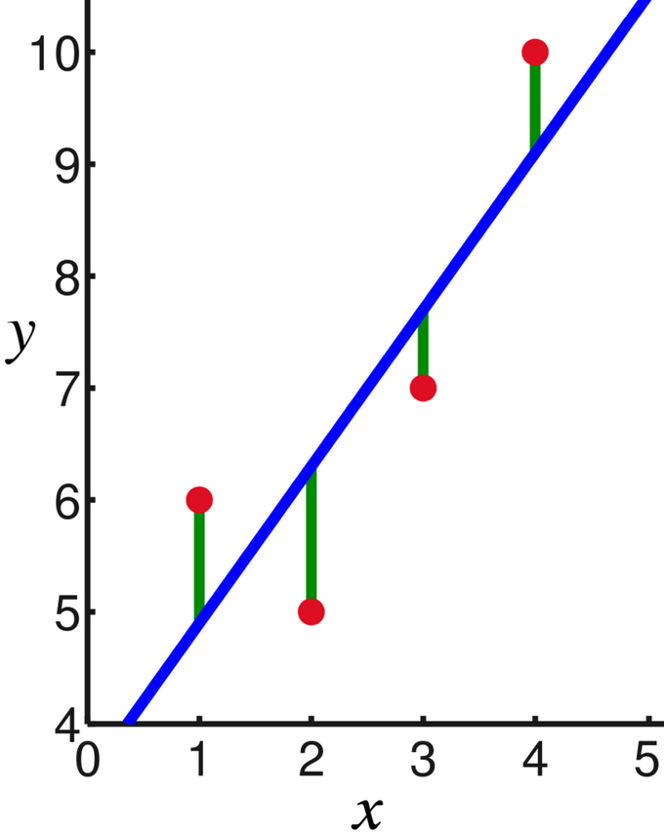

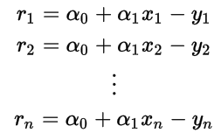

Linear Regression in Detail
Dependent variable (“regressand”): variable to be explained
Independent variable (“regressor”): explanatory variablen)
One Option: Conversion to linear equation
Parameter estimation via least square minimum:
r4
r3
r1
r2

Slide 75
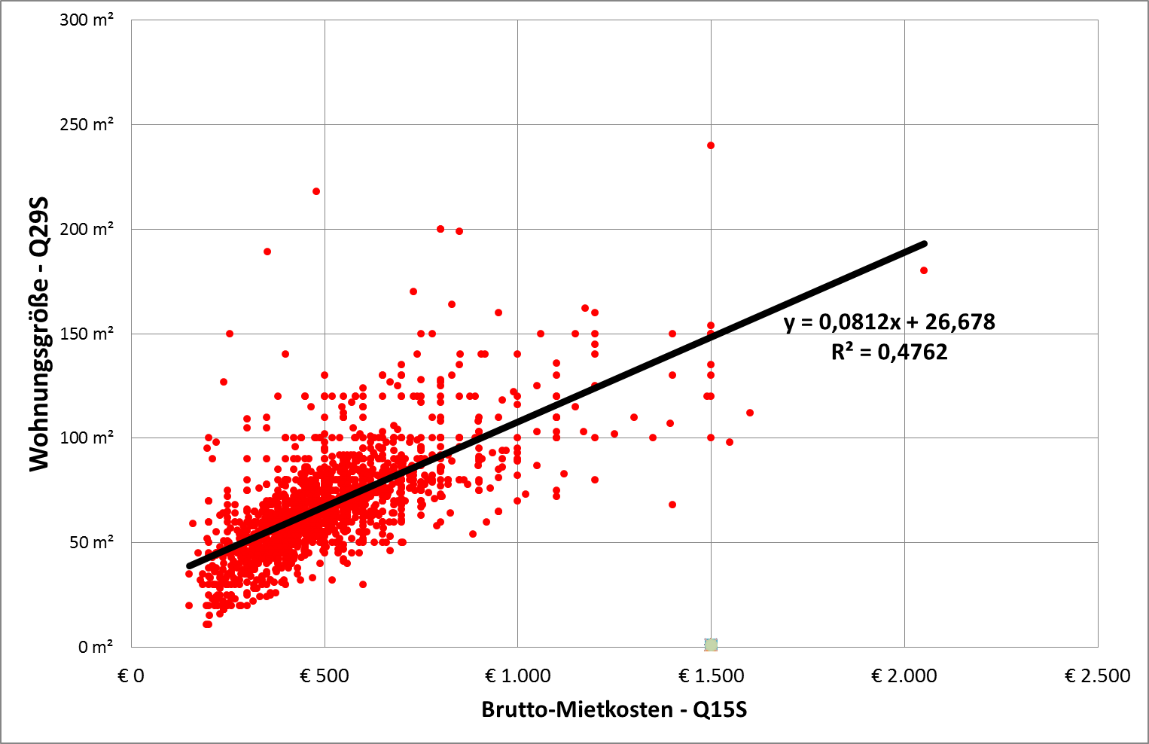
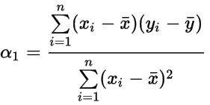
Linear Regression in Detail

Slide 76



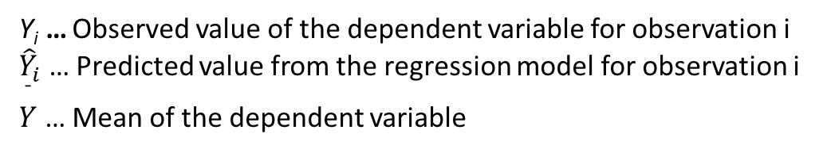
@ Güte einer gefunden Regressionslösung
Coefficient of determination R²:
Variance of the dependent variable explained by regression
Value range: 0 to 1 (= complete variance explanation)
Y_{i}​ … Observed value of the dependent variable for observation i
${\hat{Y}}_{i}$ … Predicted value from the regression model for observation i
$\overset{ˉ}{Y}$ … Mean of the dependent variable

Slide 77
Bonus: Is my Metric Variable Normally Distributed?

Slide 78

Let’s have a Look: Histogramm & Density
Look for a bell-shaped curve
The curve should be symmetrical around the centre
The left and right tails should look similar
skewness = longer tail on one side
Most values should cluster around the mean
The curve should have one clear peak
NOT: Very flat or very peaked shape

Slide 79
Let’s have a Detailed Look: Kurtosis & Skewness
N | 1450
Missing | 0
Mean | 0.653
Median | 0.750
Skewness | -0.787
Kurtosis | 0.410
Shapiro-Wilk W | 0.949
Shapiro-Wilk p | <.001
Skewness:
👉 symmetry of a distribution
Indicates values are more spread out on one side
Skewness = 0 means perfectly symmetric
Positive skew = a longer tail on the right
Negative skew = a longer tail on the left

Slide 80
Let’s have a Detailed Look: Kurtosis & Skewness
N | 1450
Missing | 0
Mean | 0.653
Median | 0.750
Skewness | -0.787
Kurtosis | 0.410
Shapiro-Wilk W | 0.949
Shapiro-Wilk p | <.001
Kurtosis:
👉 shape and tail thickness
Indicates how heavy or light the tails are compared to a normal distribution
Normal distribution has a kurtosis value close to zero
High kurtosis = more extreme values & heavier tails
Low kurtosis = fewer extreme values & lighter tails

Slide 81


Let’s have a Detailed Look: Kurtosis & Skewness

Slide 82
The Lazy Way: The Shapiro-Wilk Test
Tests if dataset = approximately normally distributed
Compares the observed data distribution to a theoretical normal distribution
Null hypothesis H0: data is normally distributed
Alternative hypothesis H1: data is not normally distributed
👉 p-value:
p ≥ α → no evidence against normality
p < α → significant deviation from normality

Slide 83
The Lazy Way: The Shapiro-Wilk Test
N | 1450
Missing | 0
Mean | 0.653
Median | 0.750
Skewness | -0.787
Kurtosis | 0.410
Shapiro-Wilk W | 0.949
Shapiro-Wilk p | <.001
p-value:
p ≥ α → no evidence against normality
p < α → significant deviation from normality
P = < 0.001 👉
Drop Null Hypothesis H0
Data is not normally distributed

Slide 84
Outlook

Slide 85
Outlook
XXX

Slide 86


So long & cheerio!

